Slide 1
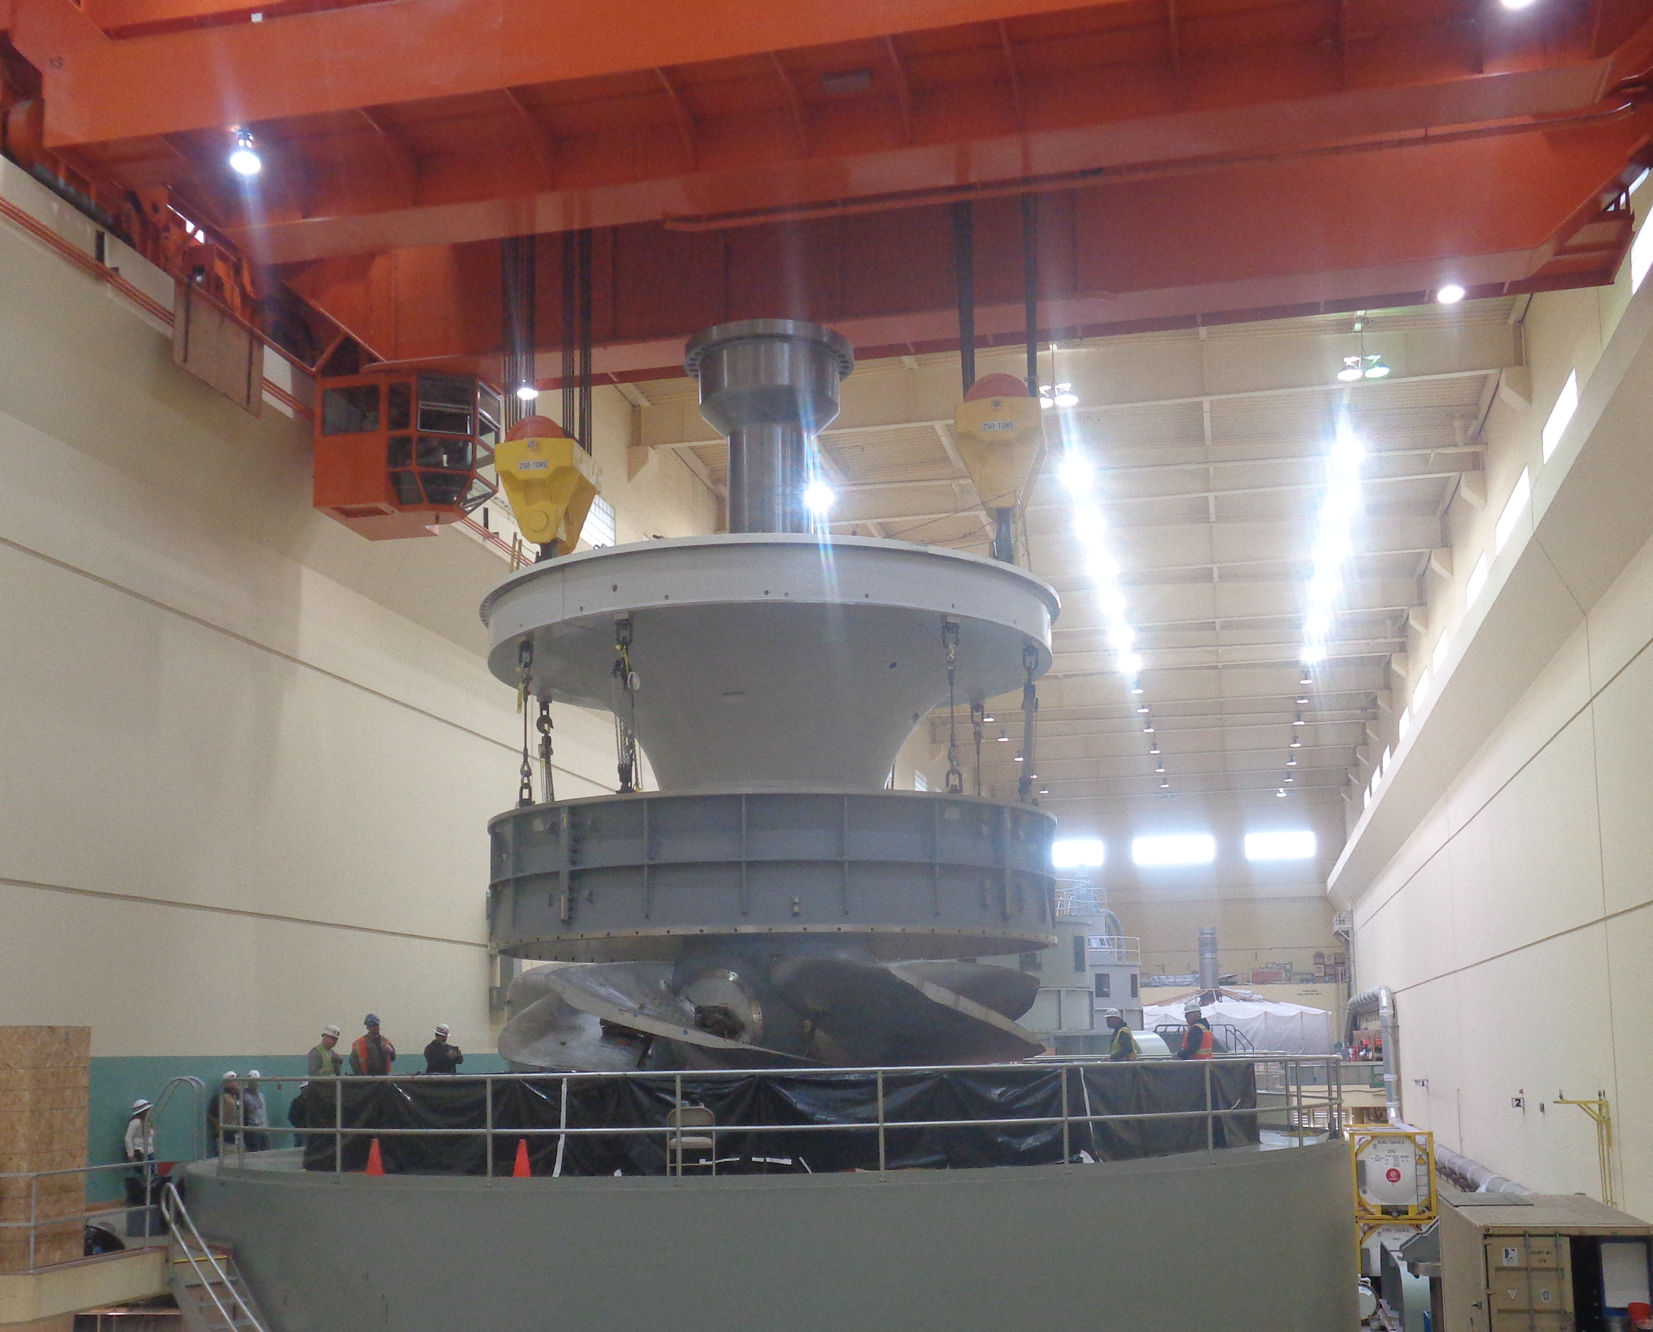
Ice Harbor Unit 3 Initial Fish Passage Operating Range

Slide 2
Ice Harbor Unit 3 – FP Operating Range
New adjustable unit 3 at Ice Harbor could start operating as early as November 2022 (depending on thrust runner machining)
  Needs fish passage operating range prior to biological testing
Default fish passage operating range in FCRPS is 1% efficiency operating range.
  Most turbines operated within 1% range since 1994 Biop based on limited study
  FPP has allowed above upper 1% at Bonneville PH1 based on ERDC modeling
Ice Harbor has significantly more CFD and physical model information than most turbines from the design process
  For new Ice Harbor adjustable very flat efficiency curve across multiple blade angles results in best fish passage operating range being within 1% range
  Flow quality considerations for low end of operating range
  Upper end needs more input from biological test

Slide 3
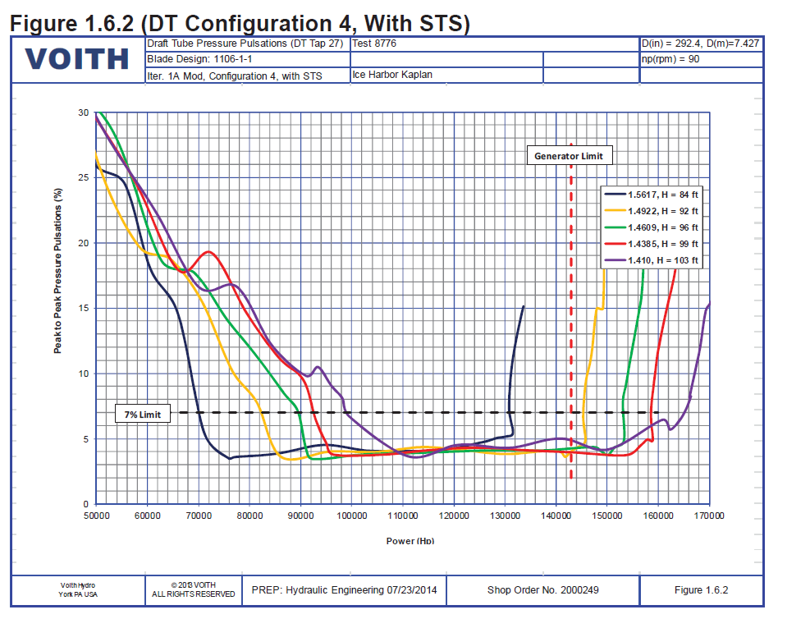
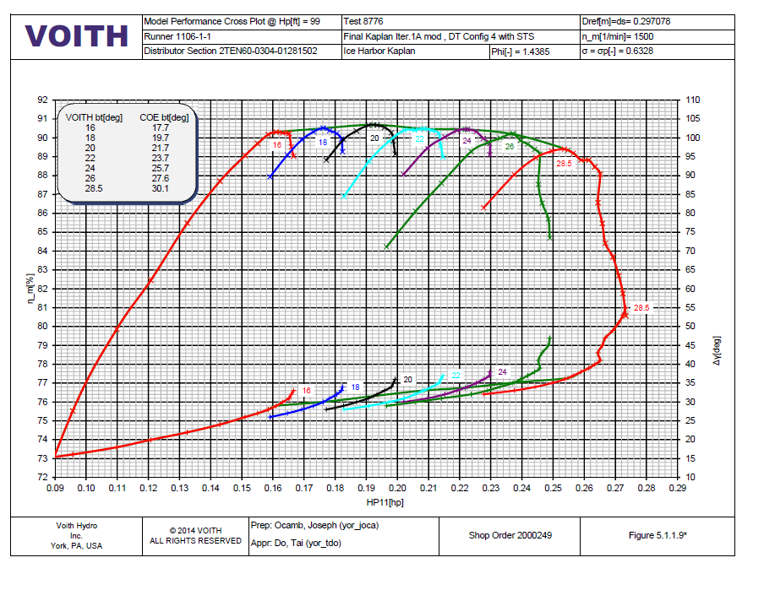
Ice Harbor Unit 3 – FP Lower Limit
Low 1% below peak efficiency for minimum blade angle.
  Draft tube flow degrades below peak of the propeller curve
    Pressure pulsation data from performance model is one indicator
  Alignment of flow to runner leading edge not optimized
  Flow delta ~ 200 – 400 cfs
  Power delta ~ 2 – 3.7 MW
Proposed Low FP Operating Point - Peak lowest BA
Proposed Low FP Operating Point - Peak lowest BA
Low 1% Operating Point
Low 1% Operating Point

Slide 4
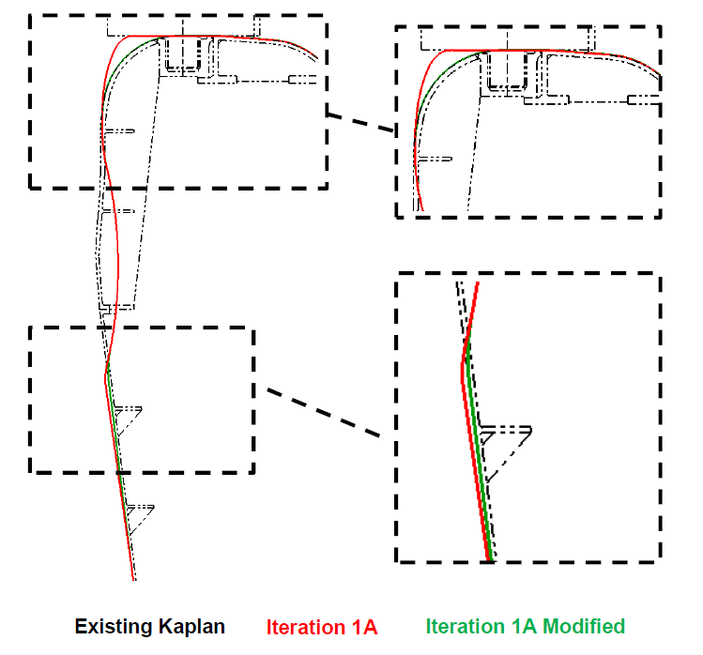
Ice Harbor Unit 3 – FP Upper Limit
New adjustable has spherical discharge ring results in 1/10 of gap between blade tip and discharge ring compared to existing
  Minor gap increase (less than ¼”) at upper end of new adjustable
Steeper blade angles often have lower strike frequency based on ERDC results
Higher flows have lower nadir pressures which can increase barotrauma
  Existing runner has much lower nadir pressure across operating range
Will consider both balloon tag study and sensor fish study to determine if difference in fish passage across operating range
Existing Runner
New Adjustable

Slide 5
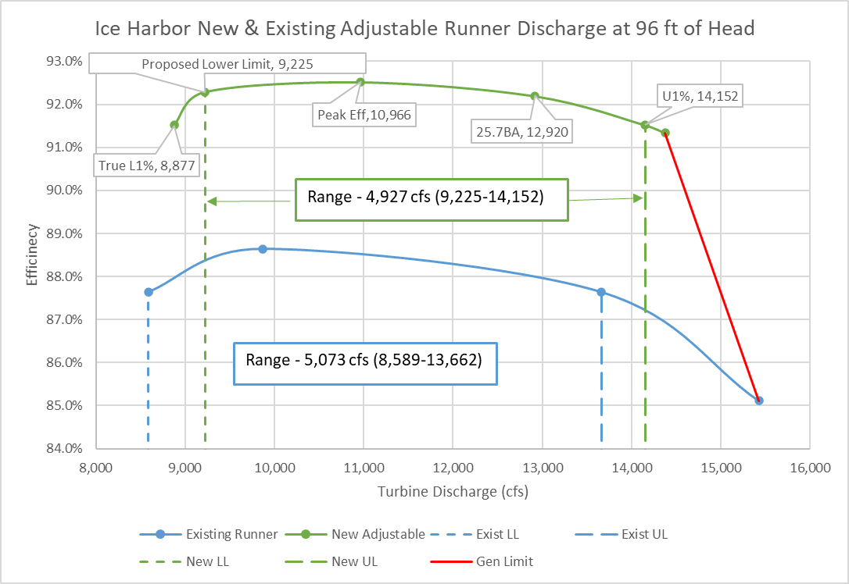
Ice Harbor Unit 3 – FP Operating Range
Initial fish passage operating range from peak of minimum blade angle to upper 1%
  Will test 4 operating points across operating range during biological test
  Biological test ~ Sept 2023
  Index tests in Mar 2023 may adjust exact operating points
Range - 35.5 MW (67.7-103.1)
* Table and graph are both with STS operation

